Slide 1

ANALYZING AND COMPRESSING IMAGES USING
WAVELET TRANSFORM
Project by
Aditya (2210993506)
Marushika (2210993538)
18 April 2024

Slide 2
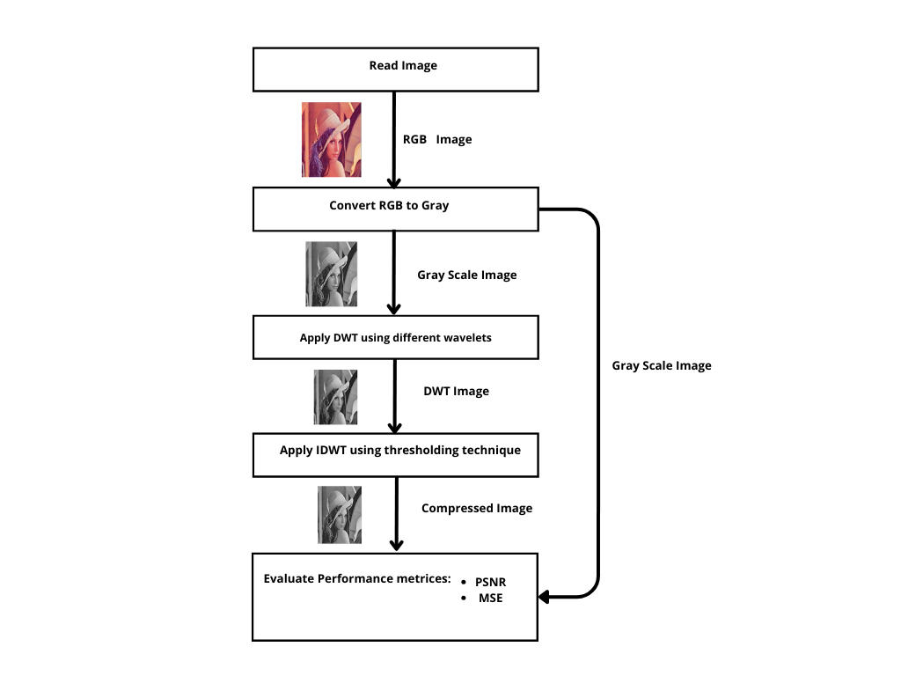
FLOWCHART
imageData = imread('image.file');
grayImage = rgb2gray(rgbImage);
[cA, cH, cV, cD] = dwt2(inputImage, waveletName);
cH_thresholded = wthresh(double(cH), 's', threshold);
compressed_image = idwt2(cA, cH_thresholded, cV, cD, wavelets{idx});
DSP PROGRESS REPORT 2024

Slide 3
COMMANDS AND CALCULATIONS
DSP PROGRESS REPORT 2025

Slide 4
COMMANDS AND CALCULATIONS
3. *Conversion Process*:
- RGB to grayscale conversion is typically done by taking a weighted sum of the R, G, and B channels.
- The weights are chosen based on the perception of human vision, where green has the highest weight, followed by red, and then blue.
- The formula commonly used for conversion is:
Gray = 0.2989 * R + 0.5870 * G + 0.1140 * B
- This formula computes a weighted sum of the RGB values to obtain the corresponding grayscale intensity.
Theory behind RGB to grayscale conversion in the context of image compression.
1. *RGB Image Representation*:
- RGB images are composed of three color channels: Red (R), Green (G), and Blue (B).
- Each pixel in an RGB image is represented by three intensity values, one for each color channel.
- The intensity values range from 0 to 255 (8-bit representation) or 0 to 1 (floating-point representation), representing the intensity of each color.
2. *Grayscale Image Representation*:
- Grayscale images are single-channel images where each pixel represents the intensity of light.
- Unlike RGB images, grayscale images have only one intensity value per pixel, ranging from 0 to 255 (8-bit) or 0 to 1 (floating-point).
- The intensity value represents the brightness or luminance of the pixel.
MATLAB COMMAND:
grayImage = rgb2gray(rgbImage);

Slide 5
COMMANDS AND CALCULATIONS
5. Quality Considerations:
- While converting RGB to grayscale reduces the size of the image, it also results in loss of color information.
- The choice of conversion method and the weights used in the conversion formula can affect the perceived quality of the grayscale image.
- In image compression applications, it's essential to balance the reduction in size with the preservation of image quality to ensure that important visual information is retained.
In summary, RGB to grayscale conversion simplifies image data by eliminating color information, resulting in smaller file sizes and potentially more efficient compression. However, the conversion process should be carefully chosen to maintain image quality while reducing size.
4. Size and Compression:
- RGB images are typically larger in size compared to grayscale images because they store color information for each pixel.
- Converting an RGB image to grayscale reduces the size by a factor of three since it eliminates the need to store color information.
- For example, if an RGB image has dimensions of 1000x1000 pixels, converting it to grayscale results in an image with the same dimensions but with only one channel instead of three.
- This reduction in size makes grayscale images more efficient for compression algorithms like JPEG, PNG, or GIF.
DSP PROGRESS REPORT 2025

Slide 6
DISCRETE WAVELET TRANSFORM:
Decomposition:
- Decomposes a signal or image into approximation and detail coefficients.
Filtering:
- Applies a low-pass filter (approximation filter) and a high-pass filter (detail filter) to extract frequency components.
- Low-pass filter extracts approximate (low-frequency) components.
- High-pass filter extracts detail (high-frequency) components.
Downsampling:
- Reduces the size of coefficients while preserving essential frequency information.
- Downsampling is applied after filtering to reduce data size.
Applications:
- Compression: Sparse representation suitable for compression algorithms.
- Feature Extraction: Extracts relevant features from signals or images.
- Image Denoising: Suppresses noise through thresholding of detail coefficients.
- Image Fusion: Combines multiple images or modalities into a single representation.
Benefits:
- Provides multi-resolution representation capturing local and global characteristics.
- Effective in analyzing and processing signals and images in various domains.
MATLAB COMMAND
[cA, cH, cV, cD] = dwt2(image, wavelets{idx});

Slide 7
PROGRESS STATISTICS
HORIZONTAL DETAIL COEFFICIENT:
1. High-Frequency Information: The horizontal detail coefficient represents high-frequency details in the horizontal direction of an image after applying a 2D Discrete Wavelet Transform (DWT).
2. Edge Information: It contains information about horizontal edges and fine details present in the image, capturing variations in pixel intensities along the horizontal axis.
3. Wavelet Decomposition: During wavelet decomposition, the image is decomposed into four components: approximation (low-frequency), horizontal detail, vertical detail, and diagonal detail coefficients.
4. Compression Potential: Manipulating the horizontal detail coefficient enables compression by reducing the amount of high-frequency information, which can be thresholded or quantized to discard less perceptually important details.
5. Trade-off: Adjusting the compression level by modifying the horizontal detail coefficient involves a trade-off between compression ratio and image quality, where higher compression may lead to loss of fine details and sharpness in the reconstructed image.

Slide 8
PROGRESS STATISTICS
APPROXIMATION COEFFICIENT:
1. Low-Frequency Component: The approximation coefficient captures the low-frequency components of an image after applying the 2D Discrete Wavelet Transform (DWT).
2. Smoothed Image Representation: It provides a smoothed version of the original image, containing general structural information and coarse features while filtering out high-frequency details.
3. Compression Basis: The approximation coefficient serves as a basis for image compression, as it contains the bulk of the image's energy and information in the lower frequency bands.
4. Downsampling: During the DWT process, the original image is successively filtered and downsampled, resulting in multiple levels of approximation coefficients corresponding to different resolution levels.
5. Hierarchy in Multiresolution Analysis: The approximation coefficients at different levels of the wavelet decomposition form a hierarchy in multiresolution analysis, with each level capturing progressively broader spatial frequency bands.

Slide 9
PERFORMANCE METRICES:
PSNR
MSE

Slide 10

PERFORMANCES METRICES
MSE(Mean Squared Error):
Quantification of Error: MSE quantifies the average squared difference between the intensity values of corresponding pixels in two images. It measures the overall discrepancy or error between the original and reconstructed images.
Use in Image Compression: In the context of image compression, MSE is often used as a quality measure to evaluate the performance of compression algorithms. Lower MSE values imply better compression performance, indicating that the compressed image closely resembles the original with minimal distortion.
COMMAND in MATLAB:
MSE_value = immse(originalImage, reconstructedImage);
FORMULA:

Slide 11

PERFORMANCES METRICES
PSNR(Peak Signal Noise to Ratio):
Quantification of Quality: PSNR quantifies the quality of the reconstructed image by measuring the ratio of the peak signal strength to the noise introduced by compression or reconstruction errors.
Higher Value, Better Quality: PSNR is typically expressed in decibels (dB), and a higher PSNR value indicates better quality, meaning that the reconstructed image closely resembles the original with minimal distortion.
Interpretation : PSNR values are commonly interpreted as follows:
20 dB or less: Indicates a poor quality image.
20-30 dB: Represents acceptable quality, but with noticeable degradation.
Above 30 dB: Indicates high quality, where differences from the original are imperceptible to the human eye.
Use in Compression: In image compression, PSNR is often used to evaluate the trade-off between compression ratio and image quality. Higher PSNR values indicate less loss in image quality due to compression.
COMMAND IN MATLAB:
PSNR_value = psnr(originalImage, reconstructedImage);
FORMULA:

Slide 12
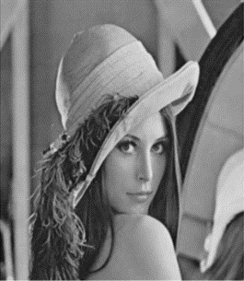
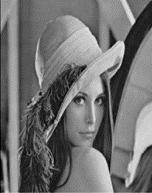
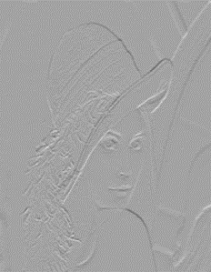
INTERPRETATION:
Approximation Coefficient
Horizontal Detail Coefficient
Compressed Image

Slide 13
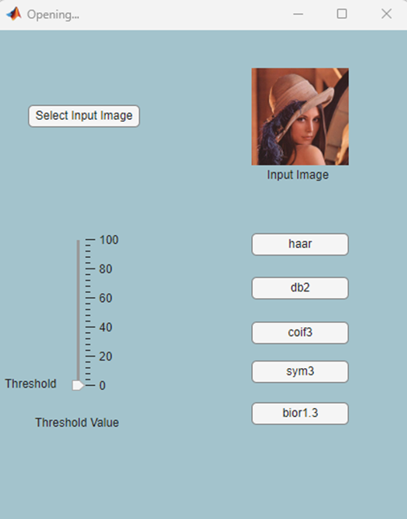
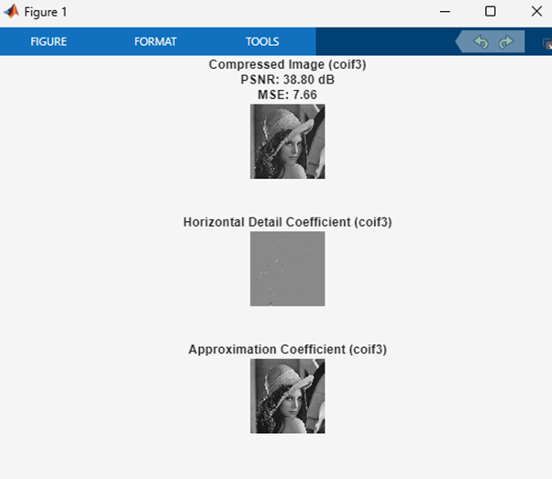
GUI:

Slide 14
CONCLUSION
 | PSNR | MSE
haar | 35.70db | 15.62
coif3 | 37.05db | 11.47
sym3 | 37.64db | 10.01
db2 | 38.17db | 8.86
bior1.3 | 35.26db | 17.28
*These values are calculated at constant threshold value of 40 and image as lena
Hence db2 is the most efficient wavelet technique in image compression

Slide 15
THANK YOU

